Slide 1

Photosynthetic Adaptations of Polar Phytoplankton to Extreme Low Light
Natasha Madeleine Ryan
Supervised By Dr. Douglas A. Campbell

Slide 2
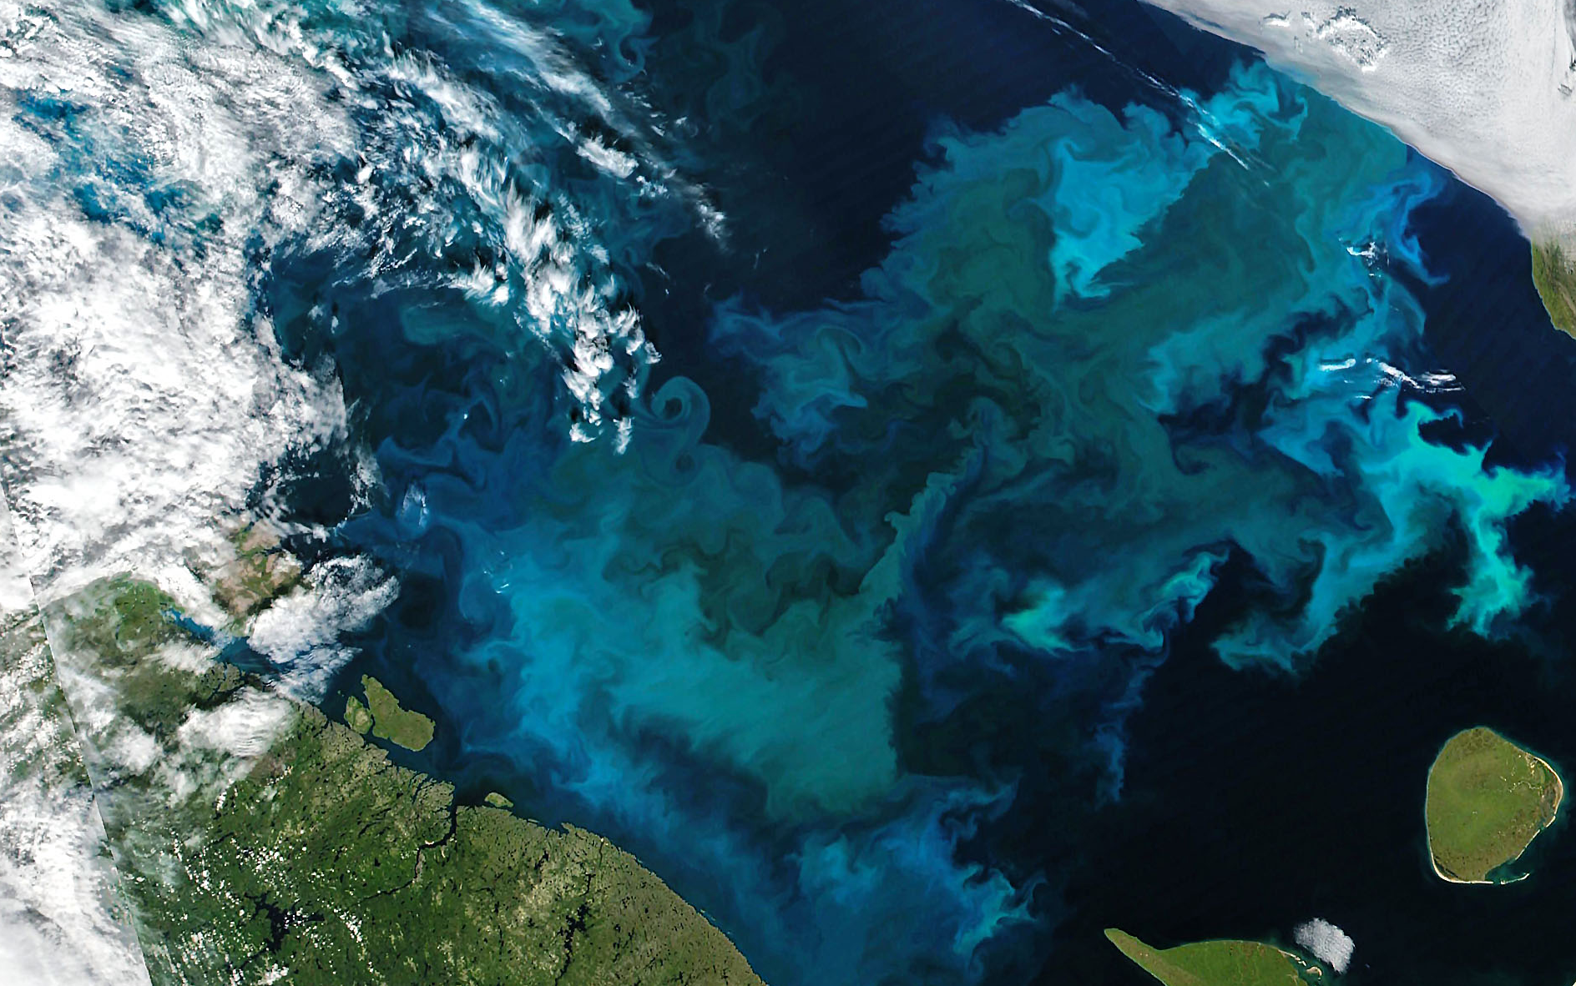
Spring Phytoplankton Blooms
Ardyna & Arrigo, 2020. Nature Climate Change Image: Phytoplankton Bloom in the Barents Sea, Joshua Stevens, NASA

Slide 3
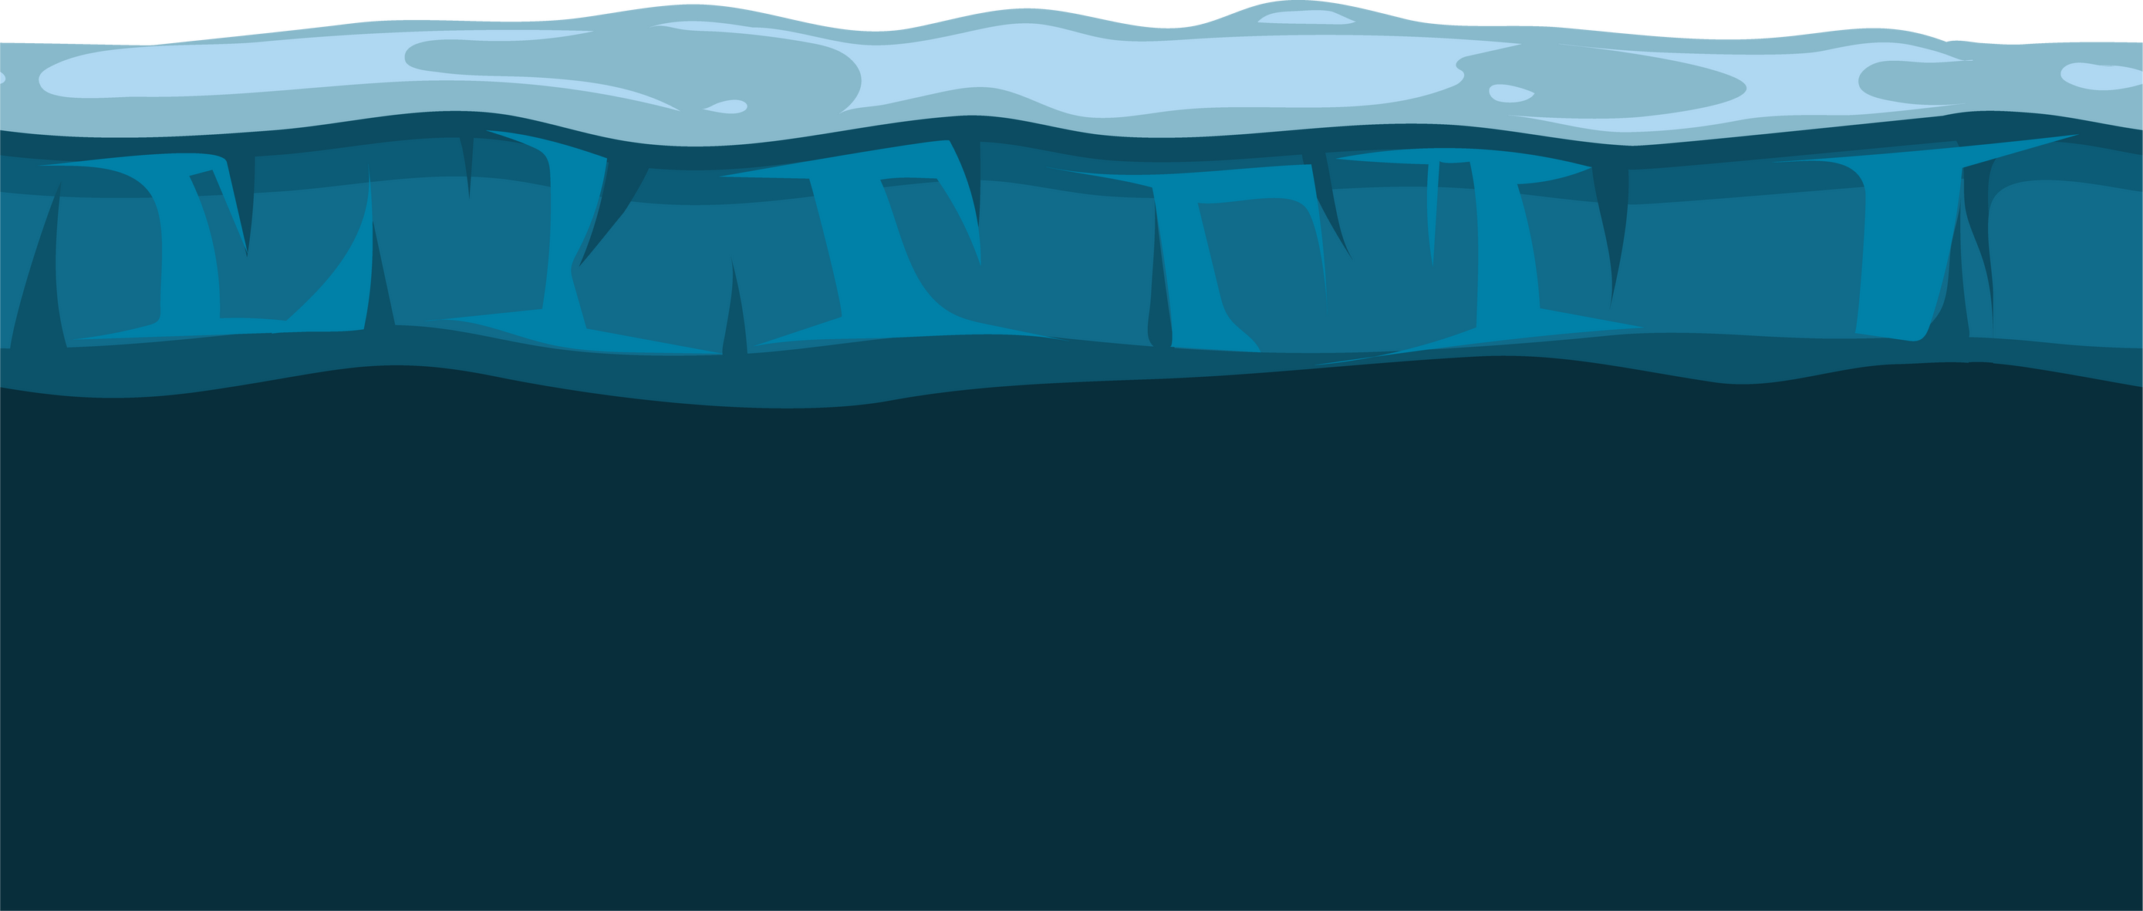
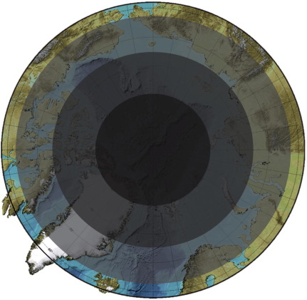
Photic Constraints
Light Attenuation
Polar Night
z
L
I
G
H
T
Randelhoff et al, 2020. Science Advances Hancke et al, 2018. Journal of Geophysical Research: Oceans Berge et al, 2015. Progress in Oceanography

Slide 4
Have polar phytoplankton adapted to extremely low light by increasing their efficiency of photosynthetic energy conversion?

Slide 5
Have polar phytoplankton adapted to extremely low light by increasing their efficiency of photosynthetic energy conversion?
Hypothesized Mechanism: suppressing energetically wasteful charge recombinations in Photosystem II

Slide 6
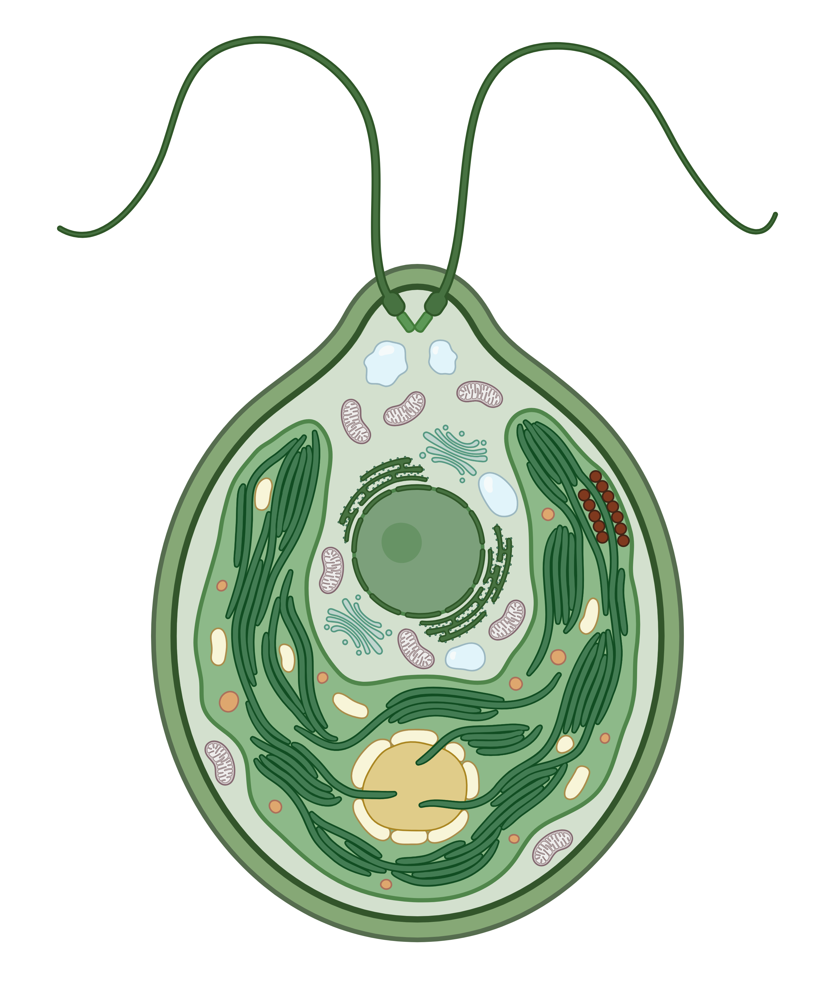
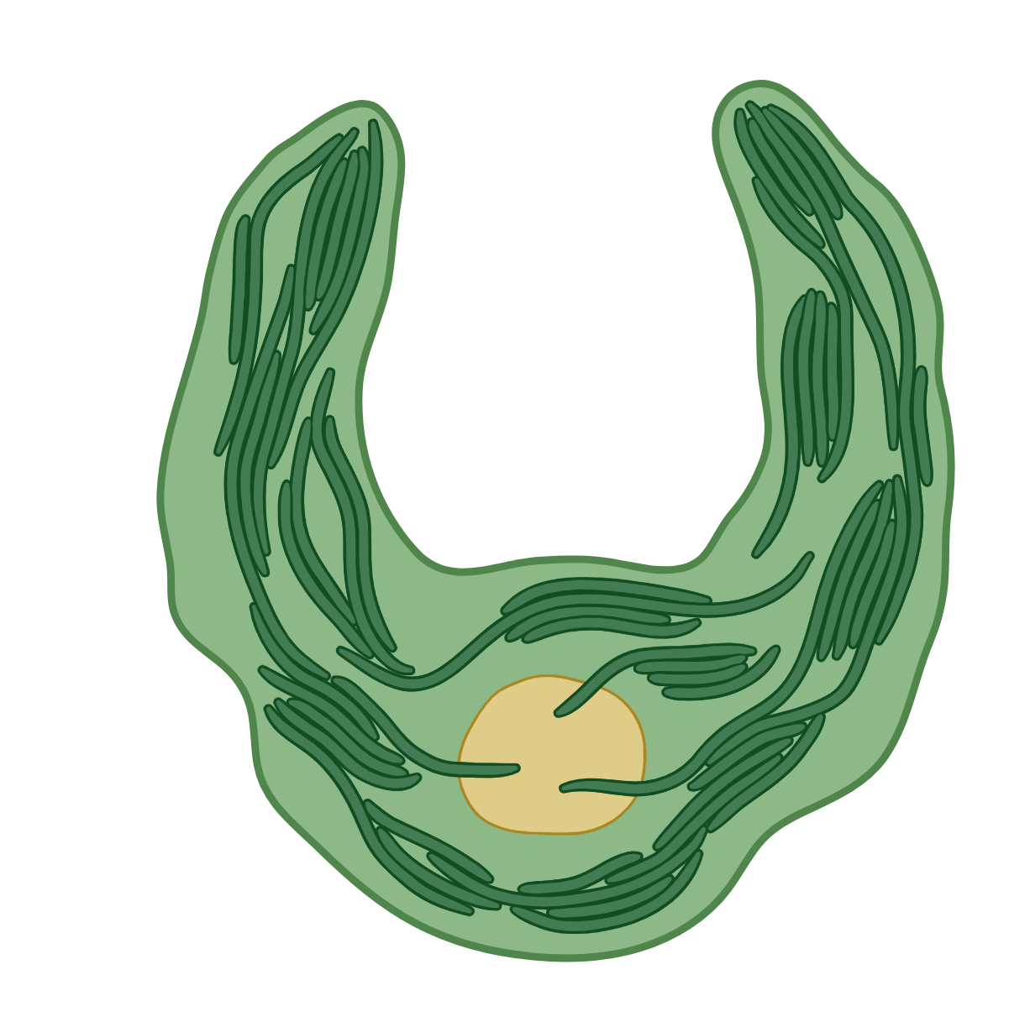
Phytoplankton Cell
Kirk, 2011. Cambridge University Press Image: BioRender

Slide 7

Chloroplast & Thylakoids
Kirk, 2011. Cambridge University Press Image: BioRender

Slide 8
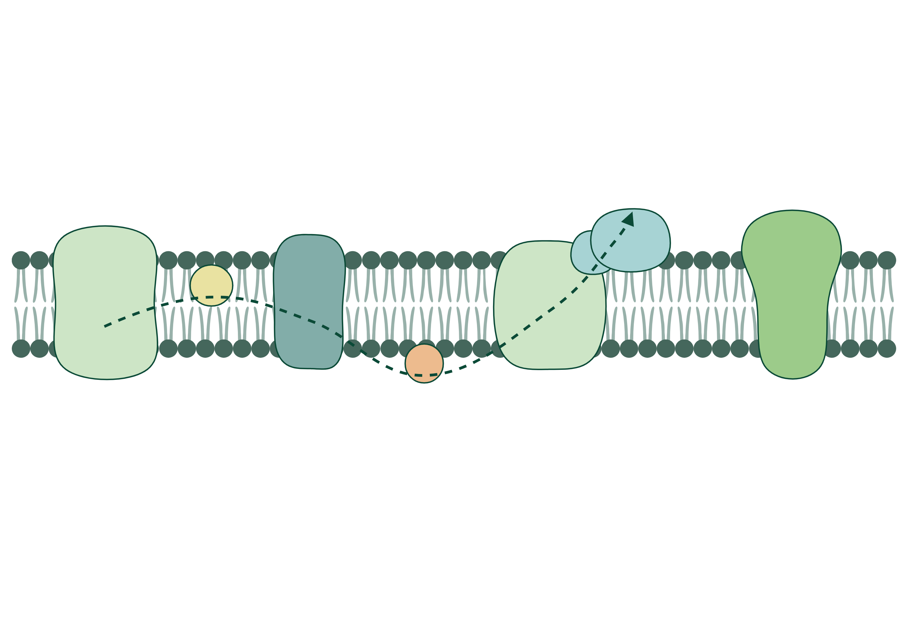
NADP⁺
NADPH
ATP
Synthase
PSII
Cyt b₆f
PSI
PQ
PC
Thylakoid Membrane
Kawakami & Shen, 2018. Methods in Enzymology Image: BioRender

Slide 9
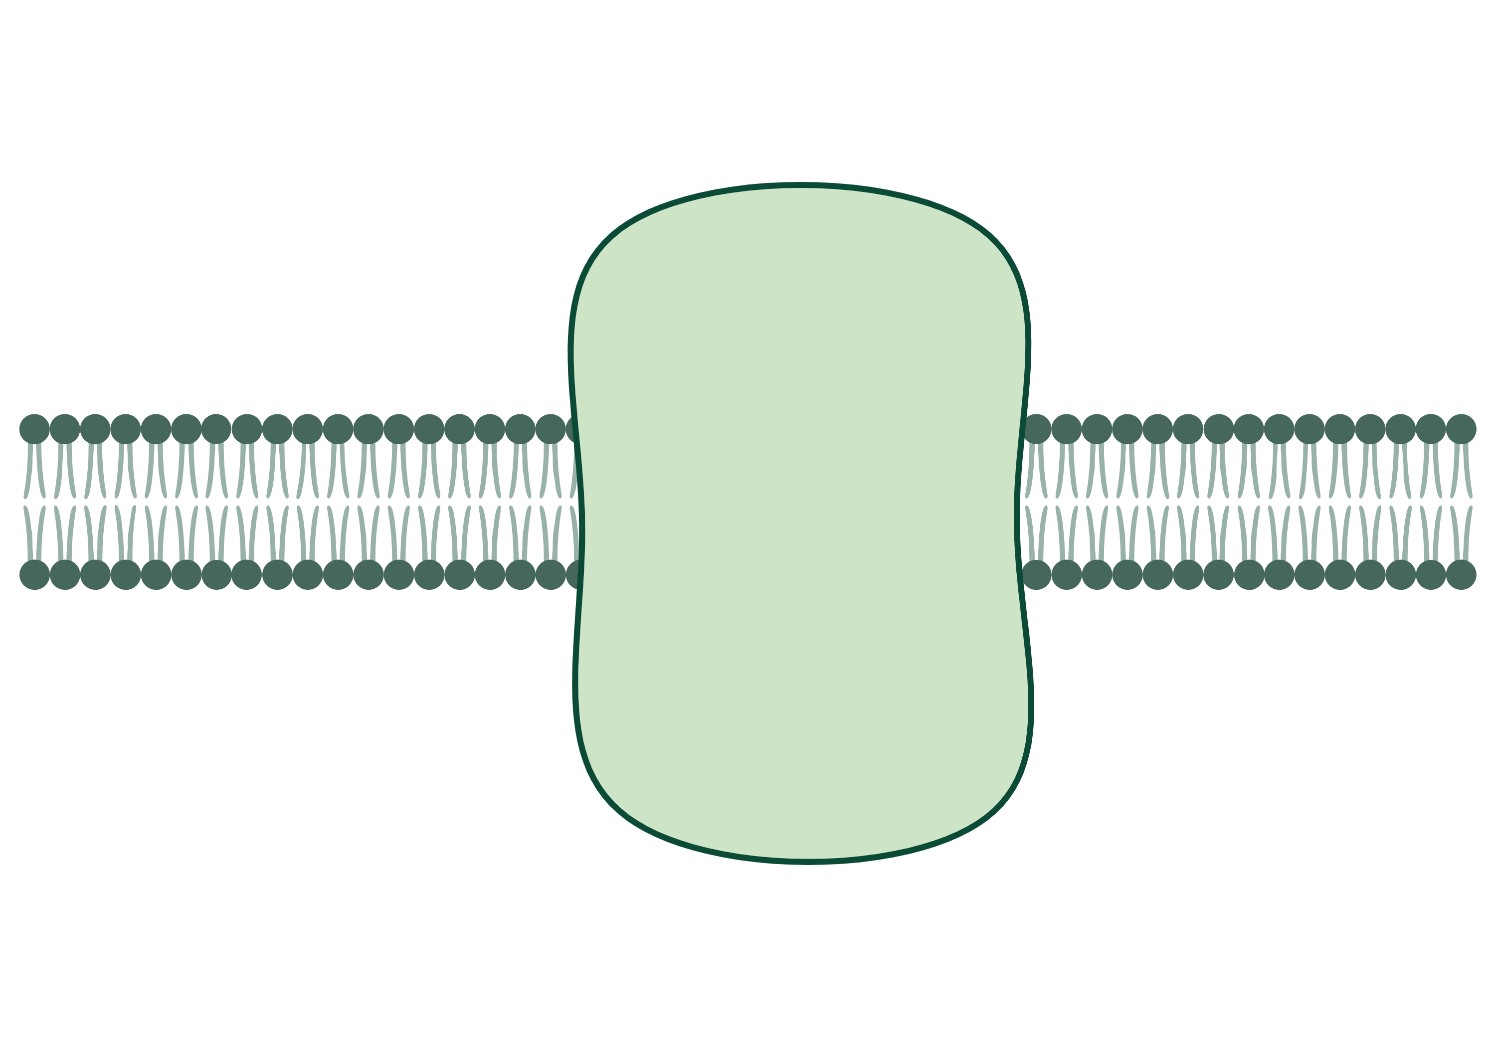
NADP⁺
NADPH
RCII
ATP
Synthase
Phe
Cyt b₆f
PSI
Q_{A}
PQ
Q_{B}
PC
RCII
Photosystem II
Gates et al., 2020. Biochimica et Biophysica Acta Mukhopadhyay et al., 2004. Chemical Reviews

Slide 10
NADP⁺
NADPH
RCII
ATP
Synthase
Phe
Cyt b₆f
PSI
Q_{A}
PQ
Q_{B}
PC
RCII
e⁻
Mn₄CaO₅
Photosystem II
Gates et al., 2020. Biochimica et Biophysica Acta Mukhopadhyay et al., 2004. Chemical Reviews

Slide 11
NADP⁺
NADPH
RCII
ATP
Synthase
Phe
Cyt b₆f
PSI
Q_{A}
PQ
Q_{B}
PC
RCII
e⁻
e⁻
Mn₄CaO₅
e⁻
e⁻
2H₂O
4H⁺ + O₂
Photosystem II
Gates et al., 2020. Biochimica et Biophysica Acta Mukhopadhyay et al., 2004. Chemical Reviews

Slide 12

St-ChlF Approach
e⁻
e⁻
Mn₄CaO₅
e⁻
e⁻
1
4
2
3
Gates et al., 2020. Biochimica et Biophysica Acta Zaharieva & Dau, 2019. Frontiers in Plant Science Schuback et al., 2021. Frontiers in Marine Science

Slide 13
Recombination
RCII
Phe
Q_{A}
e⁻
Q_{B}
e⁻
e⁻
RCII
Vass, 2011. Physiologia Plantarum Rappaport et al, 2005. Biophysical Journal

Slide 14
Wavelet Transformation
Sample Plots: Fragilariopsis cylindrus at 0°C and 0.6 µmol photons m⁻²s⁻¹
Raw Fluorescence Data
Fourier Wavelets
Roesch & Schmidbauer, 2018. WaveletComp Theis & Meyer-Bäse, 2010. Biomedical Signal Analysis

Slide 15
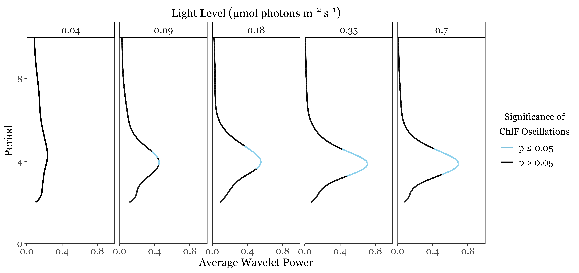
ChlF Periodicity
Sample Plot: Chlamydomonas priscuii at 8°C

Slide 16
Duration of Cycling
Sample Plot: Chlamydomonas priscuii at 8°C & 0.7 µmol photons m⁻²s⁻¹
Loss of synchronization due to energetically wasteful recombinations

Slide 17
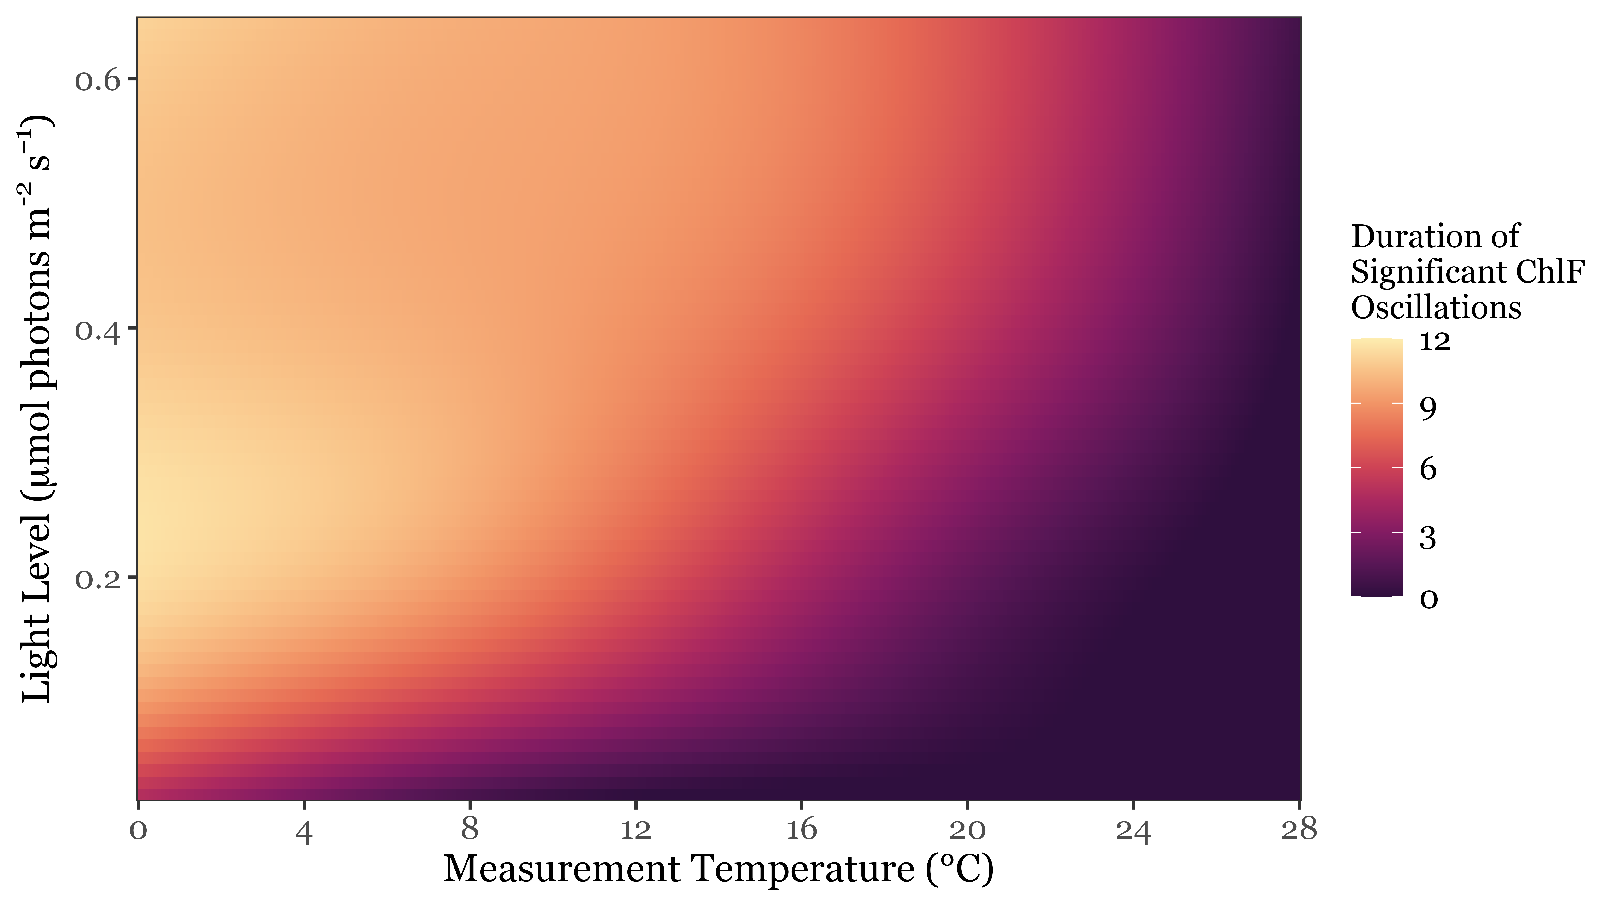
Individual strains sustain ChlF oscillations longer under measurement at higher light levels & lower temperatures

Slide 18
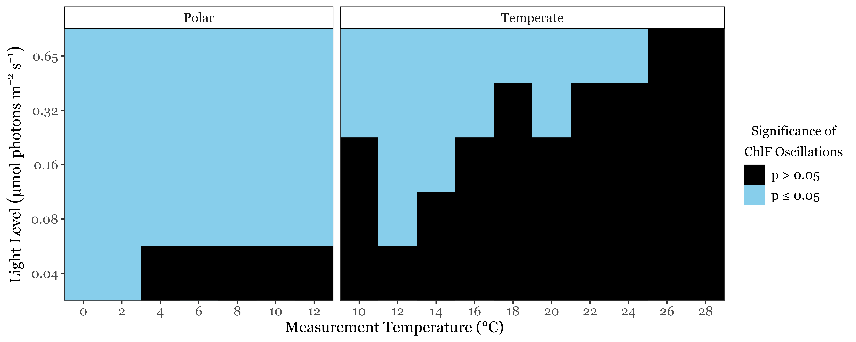
Polar strains exhibited synchronous cycling under a broader range of conditions

Slide 19
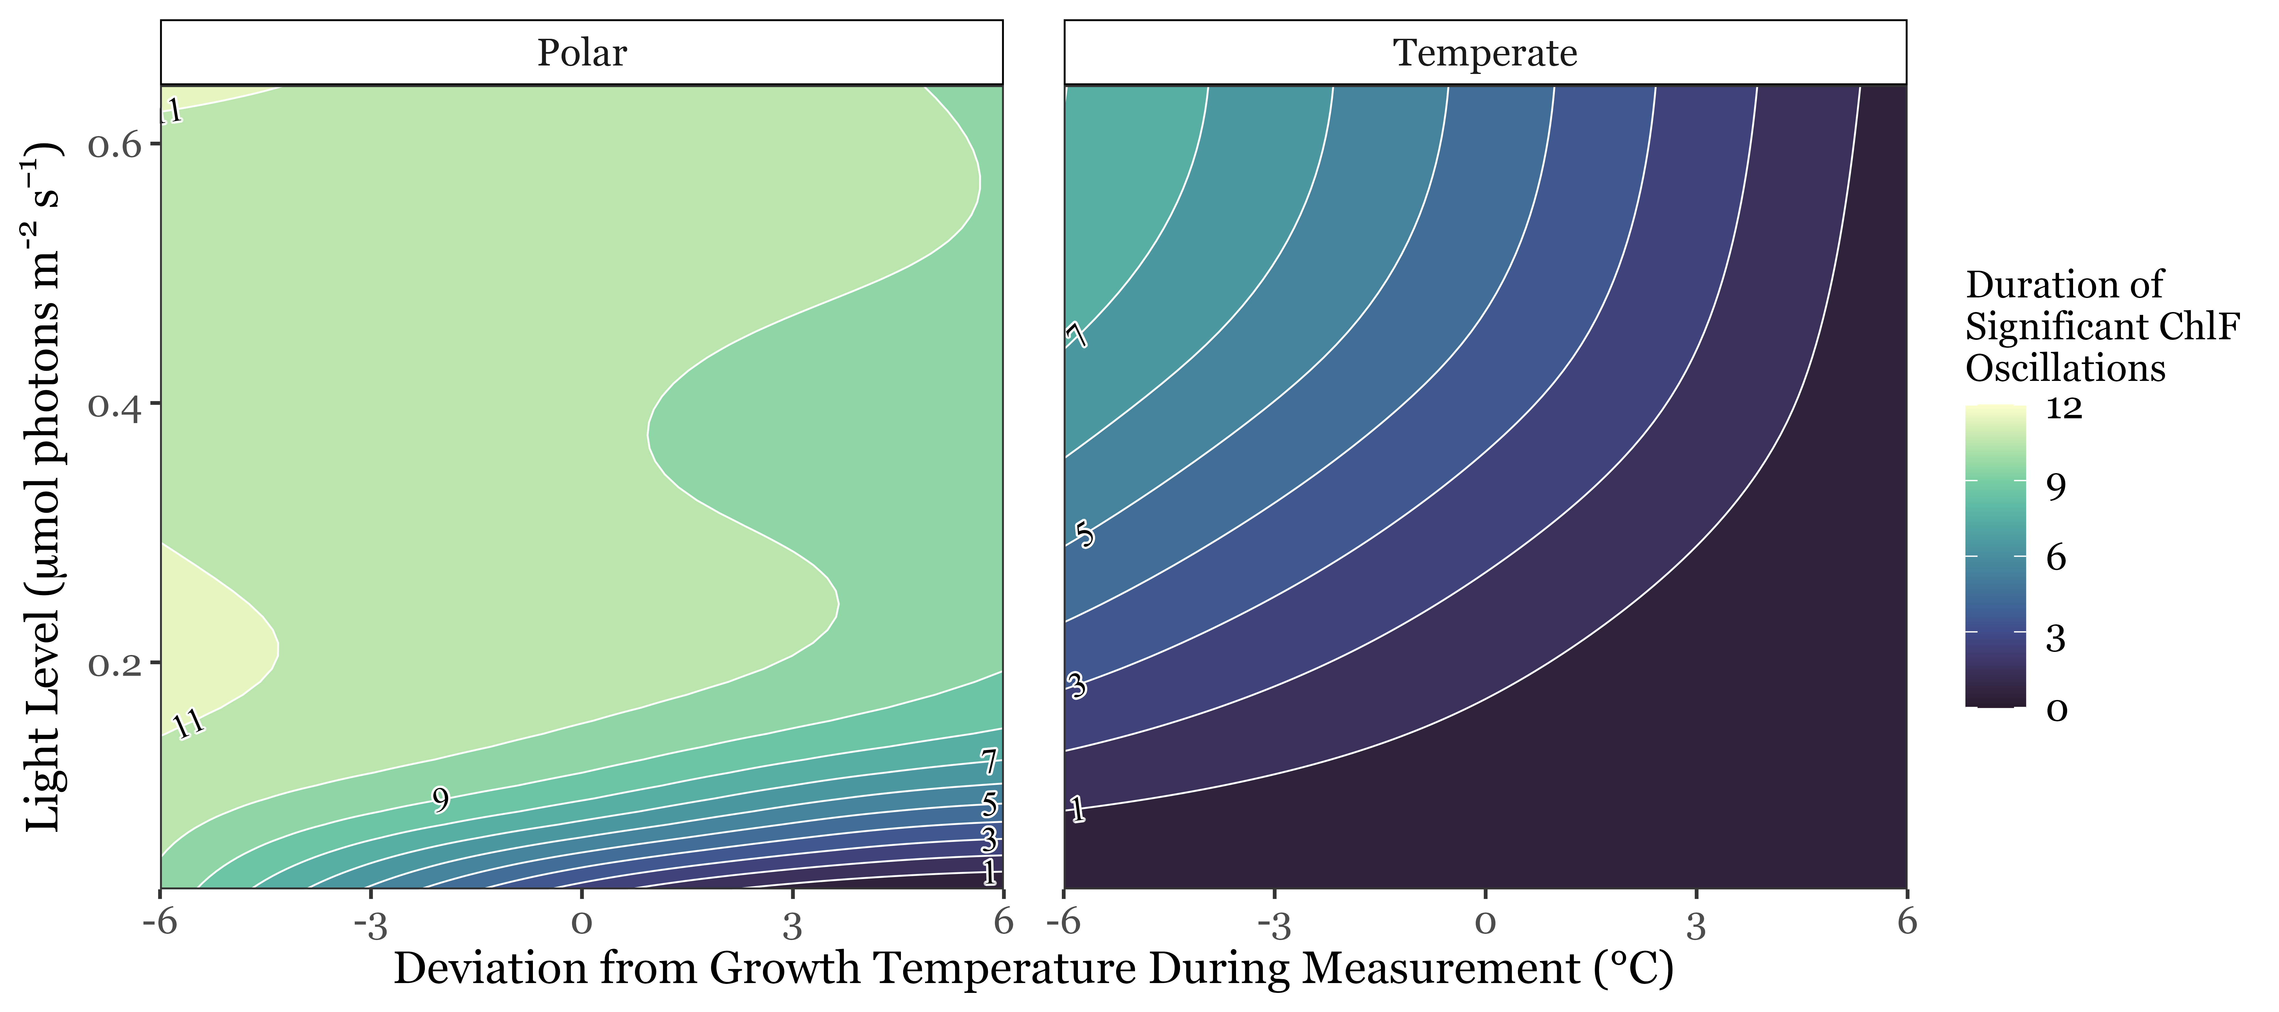
Polar strains sustained longer cycling under low light & comparable temperatures

Slide 20
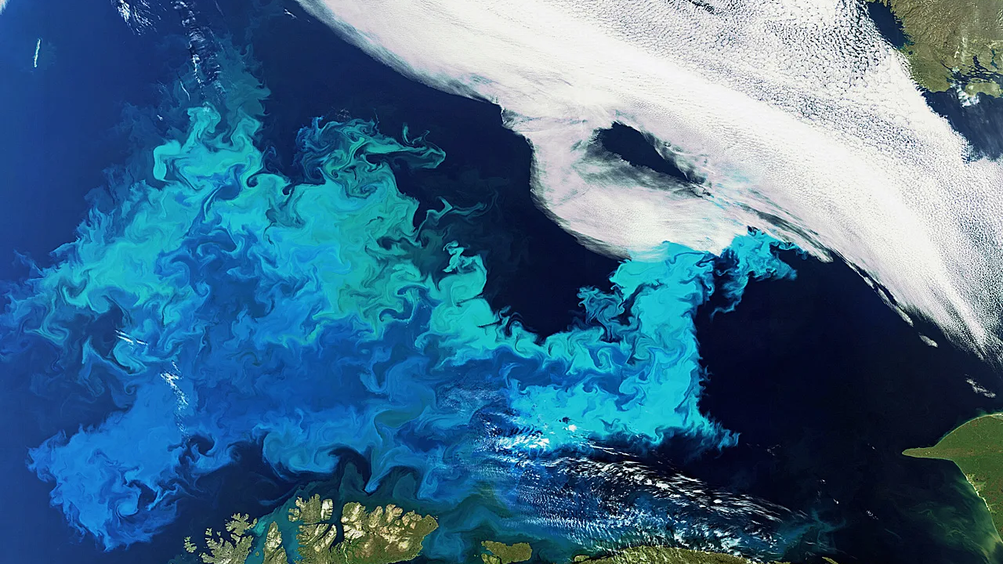
1
Within strains, longer cycling was observed at higher light levels and colder temperatures
2
Polar strains exhibit significant cycling across a broader range of conditions than temperate strains
3
Under low light & comparable temperatures, polar strains sustain longer synchronous cycling than temperate strains
Polar phytoplankton exhibit the capacity to suppress energetically wasteful charge recombinations & sustain energetically efficient photosynthesis under extremely low light
Image: European Space Agency

Slide 21
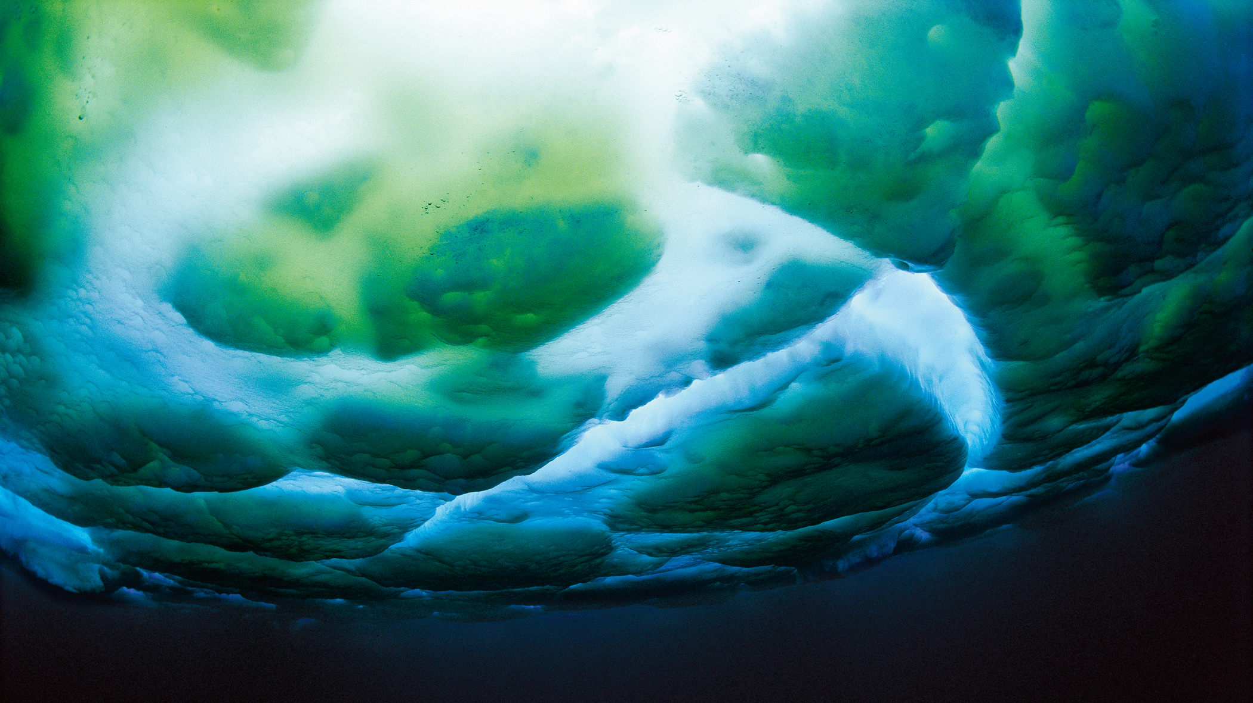





Acknowledgements
I thank my supervisor:
Dr. Douglas A Campbell
as well as Campbell Lab members:
Dr. Maximilian Berthold, Dr. Sylwia Sliwinska-Wilczewska,
Naaman Omar, Mireille Savoie, & Miranda Corkum
and our partners at
The International Research Laboratory Takuvik at Université de Laval
& Cvetkovska Lab at the University of Ottawa

Slide 22
Questions?
Image: M. Stenzel

Slide 23
References

